Slide 1
CS598 DLH Project, Summer 2023
Project Presentation by Mitch & Sathish
{sbrama2, mm109}@illinois.edu
Group ID: 195
Paper ID: 175
Paper :
SurfCon: Synonym Discovery on Privacy-Aware Clinical Data,
Proceedings of the 25th ACM SIGKDD International Conference on Knowledge Discovery
Link to Paper : https://dl.acm.org/doi/pdf/10.1145/3292500.3330894

Slide 2
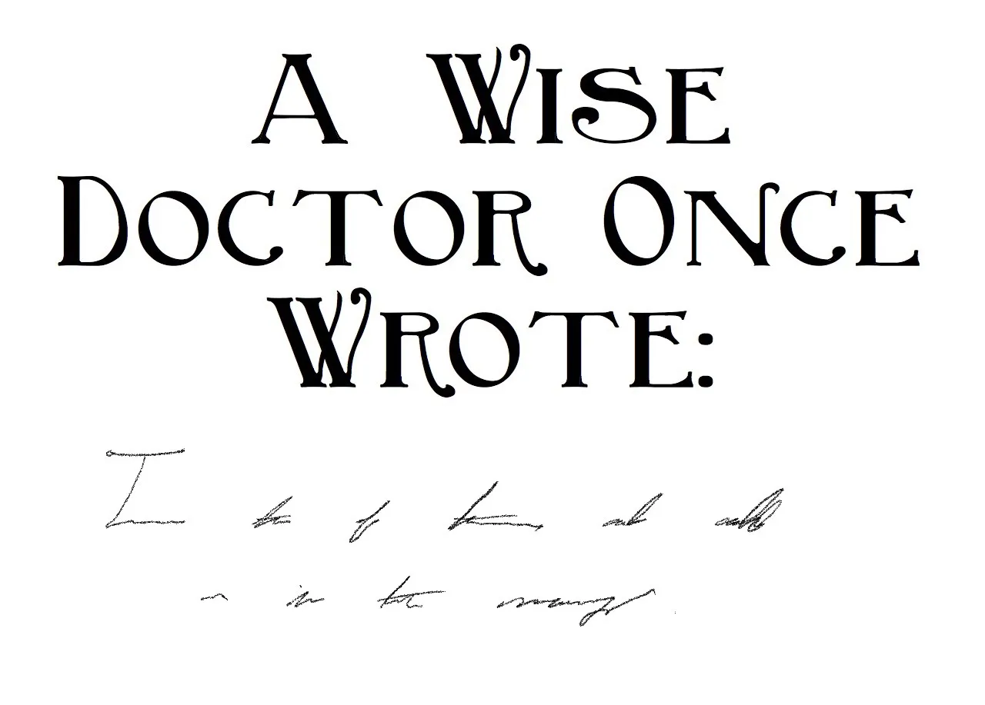
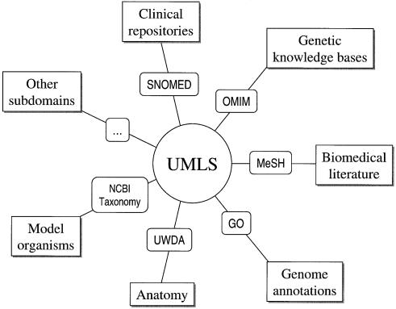
Problem
Solution
Automatically discovering synonyms (e.g., "c vitamin", "vit c", "ascorbic acid") or misspelled variations (e.g. "viatmin c") can help find valuable information such as patient-clinical interactions and disease treatment outcomes.
Documentation of medical terms in unstructured fields is error prone and often captured in shorthand
Current taxonomies (e.g. UMLS) help to group medical concepts, but do not bridge the gap to this noisy documentation
Utilize co-occurrence data of medical terms in clinical notes to build a robust synonym generation model
Consider visual similarity of terms and semantic similarity
Notes:
Automatically discovering synonyms (e.g., "c vitamin", "vit c", "ascorbic acid") or misspelled variations (e.g. "viatmin c") can help to expand the query and thereby enhance the retrieval performance to find valuable information such as patient-clinical interactions and disease treatment outcomes.
Due to patient privacy and security, it's not possible to get access to raw or de-identified clinical texts thus medical terms and their aggregated co-occurrence counts extracted from raw clinical texts are becoming a popular substitute for raw clinical texts to study EMR data.
Existing methods include mapping query terms to a Knowledge Base (KB) to retrieving synonyms, automatic synonym extraction from large corpus of wiki, similarity models between terms (ex: vit c & vitamin c), and semantic similarity models between terms using global context.
These methods have limitations such as incomplete or out of date KBs, dissimilar looking synonyms, or a challenge of getting training data in a privacy-aware setting. To address the above limitations, the paper proposes a new method called SurfCon.
The architecture consists of the following components ( Fig1 & Fig 2) :
Bi-level surface form encoding component: This exploits both character and word-level information to encode a medical term into a vector. It then computes a surface score of two terms based on their encoding vectors. This works well for detecting synonyms similar on surface form only.
Context matching component: This component utilizes the co-occurrence graph as a representation of a term’s global context. Based on a training set of term’s contexts, it seeks to predict the global context of a novel term. This allows SurfCon to construct a global relational representation of new terms to the existing library of medical terms.

Slide 3
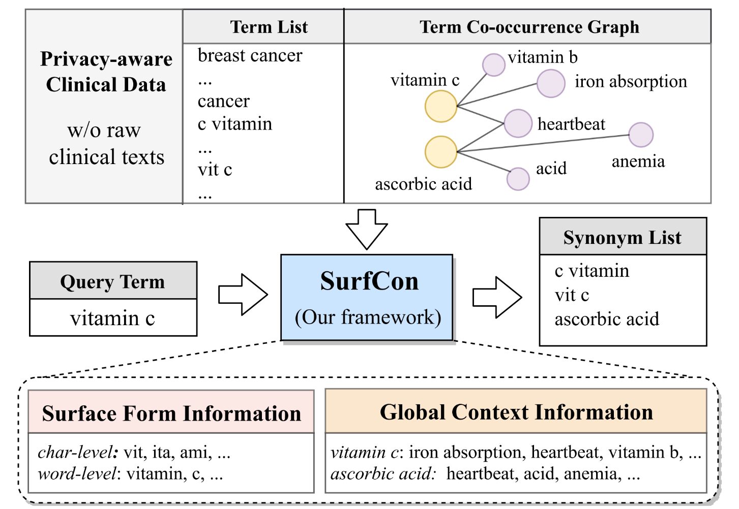
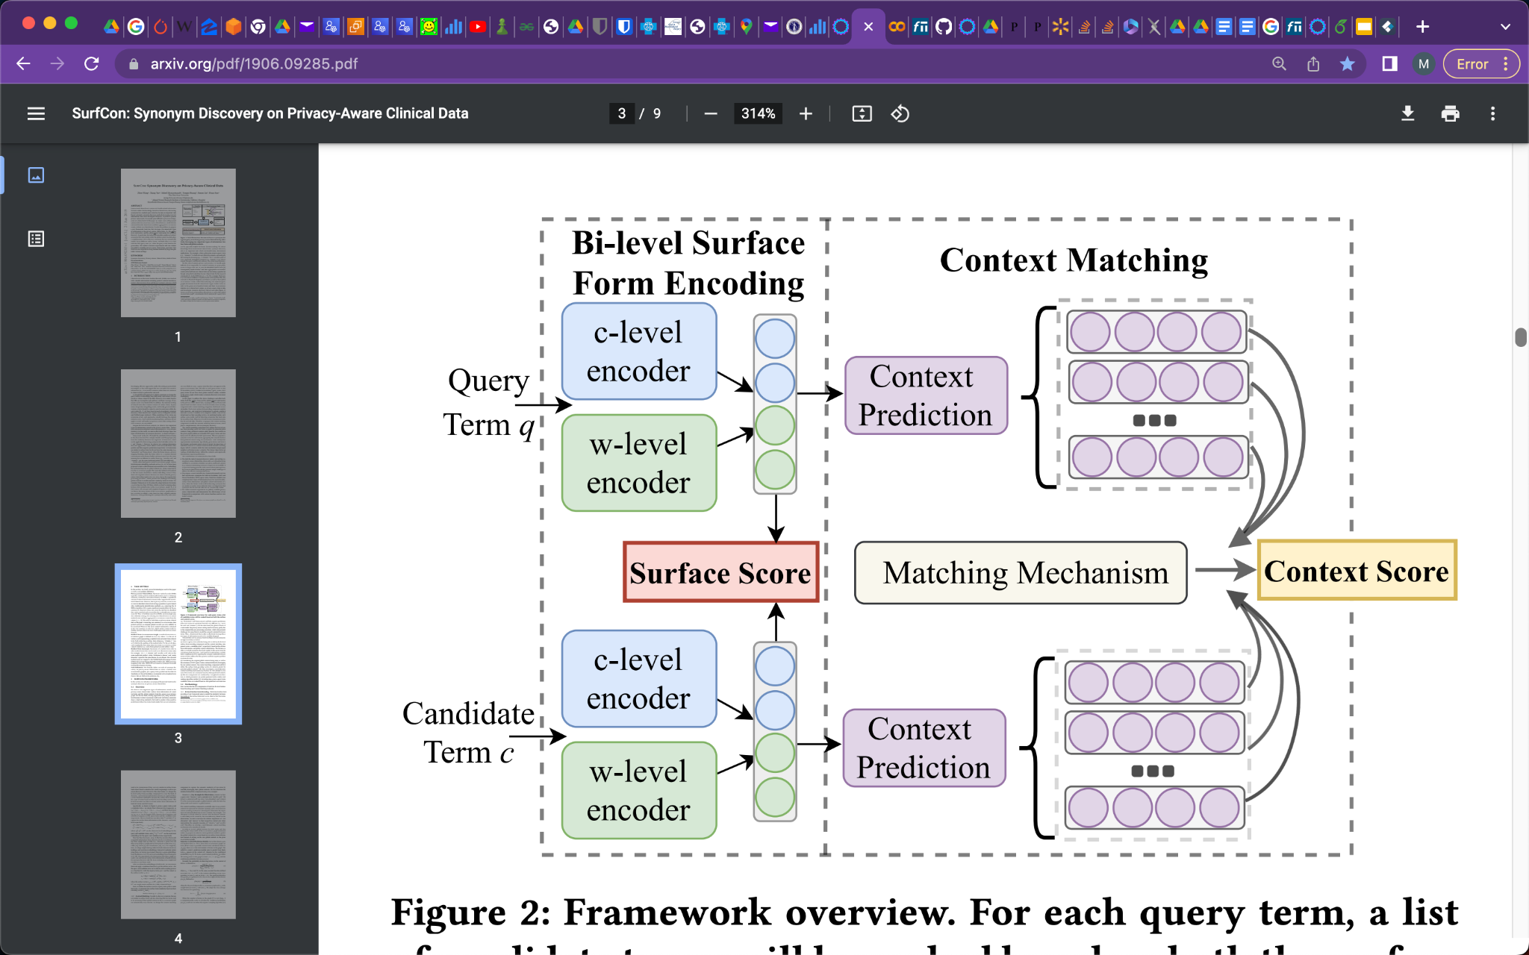
Approach
SurfCon for Synonym Generation
Build Surface Form and Global Context representation of medical terms using Character and word embeddings and co-frequency data from Clinical notes
Two information categories in privacy-aware clinical data:
Surface form information of a medical term
Global contexts from the given co-occurrence graph.
Figure 1 : SurfCon Approach
Bi-level surface form encoding component:
Model the similarity between two terms at the surface form level
Exploits both character and word-level information to encode a medical term into a vector.
Computes a surface score of two terms based on similarity
Works well for detecting synonyms similar on surface form only.
Context matching component:
Aims to discover synonyms that are not similar in surface form
Uses term’s context to represent semantic meaning
Utilizes the co-occurrence graph as a representation of a term’s global context
Generates context semantic vector for the candidate term wrt query term
Using training set of term’s contexts, seeks to predict the global context of a novel term
Figure 2 : SurfCon Architecture
Notes:
Automatically discovering synonyms (e.g., "c vitamin", "vit c", "ascorbic acid") or misspelled variations (e.g. "viatmin c") can help to expand the query and thereby enhance the retrieval performance to find valuable information such as patient-clinical interactions and disease treatment outcomes.
Due to patient privacy and security, it's not possible to get access to raw or de-identified clinical texts thus medical terms and their aggregated co-occurrence counts extracted from raw clinical texts are becoming a popular substitute for raw clinical texts to study EMR data.
Existing methods include mapping query terms to a Knowledge Base (KB) to retrieving synonyms, automatic synonym extraction from large corpus of wiki, similarity models between terms (ex: vit c & vitamin c), and semantic similarity models between terms using global context.
These methods have limitations such as incomplete or out of date KBs, dissimilar looking synonyms, or a challenge of getting training data in a privacy-aware setting. To address the above limitations, the paper proposes a new method called SurfCon.
The architecture consists of the following components ( Fig1 & Fig 2) :
Bi-level surface form encoding component: This exploits both character and word-level information to encode a medical term into a vector. It then computes a surface score of two terms based on their encoding vectors. This works well for detecting synonyms similar on surface form only.
Context matching component: This component utilizes the co-occurrence graph as a representation of a term’s global context. Based on a training set of term’s contexts, it seeks to predict the global context of a novel term. This allows SurfCon to construct a global relational representation of new terms to the existing library of medical terms.

Slide 4
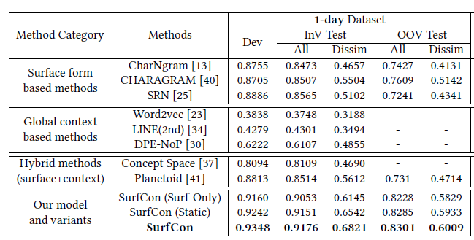
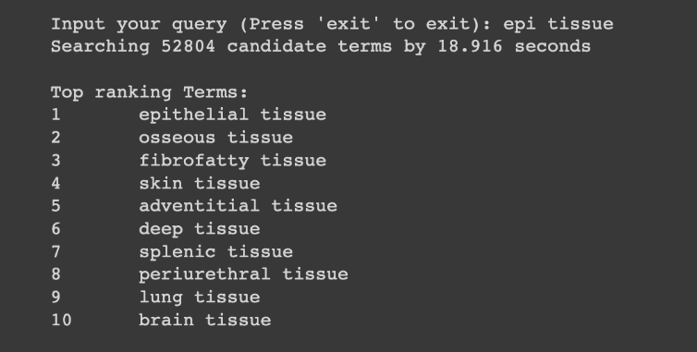
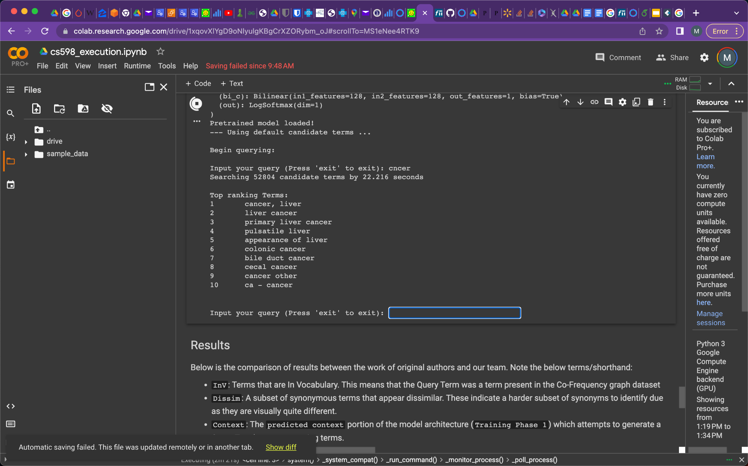
Results
Synonym Generator:
Model successfully handles shorthand and misspellings to produce synonymous terms
Handles Out of Vocabulary Terms:
Model performs well on terms that were not present in the frequency graph
Improvement over existing methods:
Model shows marked improvement from surface form, global context, and existing hybrid models. SurfCon is also robust to dissimilar terms, showing significant improvement against other methods
Notes:
Automatically discovering synonyms (e.g., "c vitamin", "vit c", "ascorbic acid") or misspelled variations (e.g. "viatmin c") can help to expand the query and thereby enhance the retrieval performance to find valuable information such as patient-clinical interactions and disease treatment outcomes.
Due to patient privacy and security, it's not possible to get access to raw or de-identified clinical texts thus medical terms and their aggregated co-occurrence counts extracted from raw clinical texts are becoming a popular substitute for raw clinical texts to study EMR data.
Existing methods include mapping query terms to a Knowledge Base (KB) to retrieving synonyms, automatic synonym extraction from large corpus of wiki, similarity models between terms (ex: vit c & vitamin c), and semantic similarity models between terms using global context.
These methods have limitations such as incomplete or out of date KBs, dissimilar looking synonyms, or a challenge of getting training data in a privacy-aware setting. To address the above limitations, the paper proposes a new method called SurfCon.
The architecture consists of the following components ( Fig1 & Fig 2) :
Bi-level surface form encoding component: This exploits both character and word-level information to encode a medical term into a vector. It then computes a surface score of two terms based on their encoding vectors. This works well for detecting synonyms similar on surface form only.
Context matching component: This component utilizes the co-occurrence graph as a representation of a term’s global context. Based on a training set of term’s contexts, it seeks to predict the global context of a novel term. This allows SurfCon to construct a global relational representation of new terms to the existing library of medical terms.

Slide 5
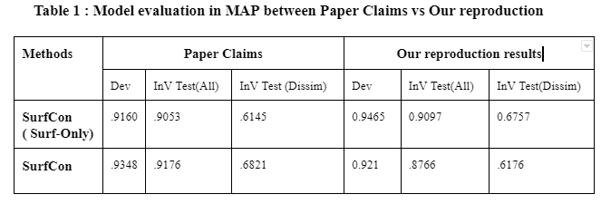
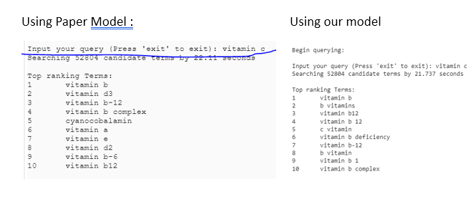
Reproduction Study
Study Outcomes
Replaced CharNGram with FastText embeddings:
Utilized pre-trained subword embeddings from FastText as a replacement for the 2-4 Gram embeddings with CharNGram
Implemented Data Loading and Preprocessing:
Build data loading and transformation code for building input datasets and labels
Implemented code to replicate data preprocessing measures including PPMI, subsampling, and data splitting
Performed Ablation Experiment:
Executed SurfCon training without Context Matching to re-evaluate significance in Synonym generation
Performed reproduction of full SurfCon Architecture:
Trained Surfcon Surface-form and Global context data, utilizing inductive global context prediction with dynamic context matching
SurfCon Innovative Approach Verified:
Even with utilizing a different pre-trained subword embedding, we were able to verify the claim that SurfCon improved the Synonym generation task over existing methods
Context Matching Claim Questioned:
Our model saw better results without the use of Context Matching for Test sets (including Dissimilar terms), calling into question the significance of this component on the task
Notes:
Automatically discovering synonyms (e.g., "c vitamin", "vit c", "ascorbic acid") or misspelled variations (e.g. "viatmin c") can help to expand the query and thereby enhance the retrieval performance to find valuable information such as patient-clinical interactions and disease treatment outcomes.
Due to patient privacy and security, it's not possible to get access to raw or de-identified clinical texts thus medical terms and their aggregated co-occurrence counts extracted from raw clinical texts are becoming a popular substitute for raw clinical texts to study EMR data.
Existing methods include mapping query terms to a Knowledge Base (KB) to retrieving synonyms, automatic synonym extraction from large corpus of wiki, similarity models between terms (ex: vit c & vitamin c), and semantic similarity models between terms using global context.
These methods have limitations such as incomplete or out of date KBs, dissimilar looking synonyms, or a challenge of getting training data in a privacy-aware setting. To address the above limitations, the paper proposes a new method called SurfCon.
The architecture consists of the following components ( Fig1 & Fig 2) :
Bi-level surface form encoding component: This exploits both character and word-level information to encode a medical term into a vector. It then computes a surface score of two terms based on their encoding vectors. This works well for detecting synonyms similar on surface form only.
Context matching component: This component utilizes the co-occurrence graph as a representation of a term’s global context. Based on a training set of term’s contexts, it seeks to predict the global context of a novel term. This allows SurfCon to construct a global relational representation of new terms to the existing library of medical terms.

